Slide 1
Artificial Intelligence (AI)
Topic 2: Problem Solving Agents (Part -VII)

Slide 2
Agenda
Uninformed Search Algorithms
Learning Outcomes : Searching Algorithms
Methodology and Assessment Criteria for the Subject

Slide 3
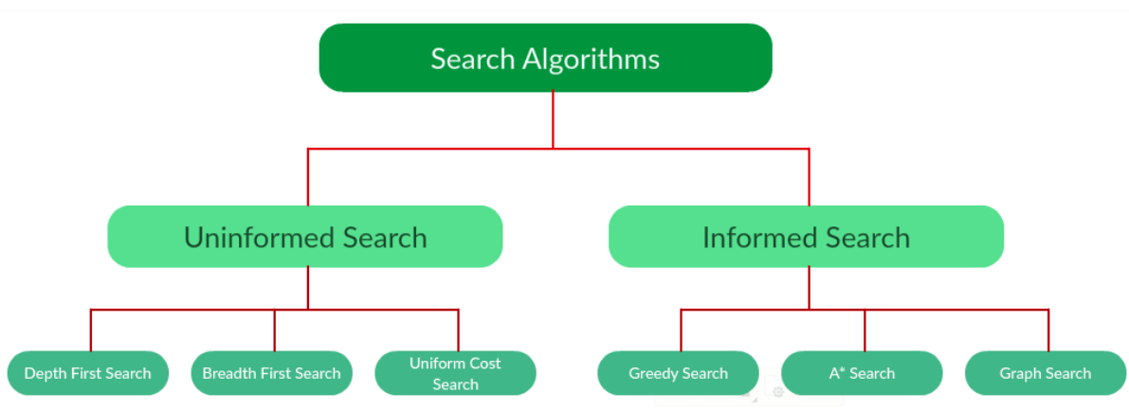
Types of Search Algorithms

Slide 4
Searching Strategies
Blind search → traversing the search space until the goal nodes is found (might be doing exhaustive search).
Techniques : Breadth First Uniform Cost ,Depth first, Interactive Deepening search.
Guarantees solution.
Heuristic search → search process takes place by traversing search space with applied rules (information).
Techniques: Greedy Best First Search, A* Algorithm
There is no guarantee that solution is found.

Slide 5
Example: Traveling Salesperson Problem
Suppose a salesperson has five cities to visit and them must return home. Goal → find the shortest path to travel.
A
B
75
125
125
100
75
E
50
125
C
50
D
100

Slide 6
Measuring Searching Performance
The output from problem-solving (searching) algorithm is either FAILURE or SOLUTION.
Four ways:
Completeness : is guaranteed to find a solution?
Optimality: does it find optimal solution ?
Time complexity: how long?
Space complexity: how much memory?
Complexity : branching factor (b), depth (d), and max. depth (m)

Slide 7
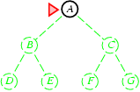
Breadth-first search
Expand shallowest unexpanded node
Implementation:
fringe is a FIFO queue, i.e., new successors go at end

Slide 8
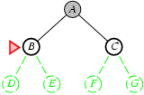
Breadth-first search
Expand shallowest unexpanded node
Implementation:
fringe is a FIFO queue, i.e., new successors go at end

Slide 9
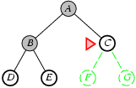
Breadth-first search
Expand shallowest unexpanded node Implementation:
fringe is a FIFO queue, i.e., new successors go at end

Slide 10
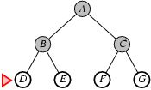
Breadth-first search
Expand shallowest unexpanded node Implementation:
fringe is a FIFO queue, i.e., new successors go at end

Slide 11
Properties of breadth-first search
Complete? Yes (if b is finite)
Time? 1+b+b²+b³+… +b^{d} + b(b^{d}-1) = O(b^{d+1}) Space? O(b^{d+1}) (keeps every node in memory) Optimal? Yes (if cost = 1 per step) Space is the bigger problem (more than time)

Slide 12
Uniform-cost search
Expand least-cost unexpanded node
Implementation:
fringe = queue ordered by path cost
Equivalent to breadth-first if step costs all equal
Complete? Yes, if step cost ≥ ε
Time? # of nodes with g ≤ cost of optimal solution, O(b^{ceiling(C*/ ε)}) where C* is the cost of the optimal solution
Space? # of nodes with g ≤ cost of optimal solution, O(b^{ceiling(C*/ ε)})
Optimal? Yes – nodes expanded in increasing order of g(n)

Slide 13
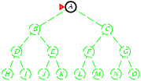
Depth-first search
Expand deepest unexpanded node
Implementation:
fringe = LIFO queue, i.e., put successors at front

Slide 14
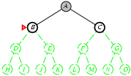
Depth-first search
Expand deepest unexpanded node
Implementation:
fringe = LIFO queue, i.e., put successors at front

Slide 15
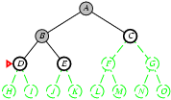
Depth-first search
Expand deepest unexpanded node
Implementation:
fringe = LIFO queue, i.e., put successors at front

Slide 16
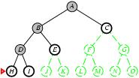
Depth-first search
Expand deepest unexpanded node
Implementation:
fringe = LIFO queue, i.e., put successors at front

Slide 17
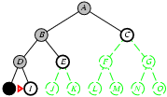
Depth-first search
Expand deepest unexpanded node
Implementation:
fringe = LIFO queue, i.e., put successors at front

Slide 18
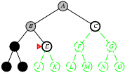
Depth-first search
Expand deepest unexpanded node
Implementation:
fringe = LIFO queue, i.e., put successors at front

Slide 19
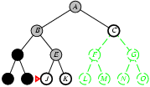
Depth-first search
Expand deepest unexpanded node Implementation:
fringe = LIFO queue, i.e., put successors at front

Slide 20
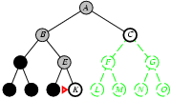
Depth-first search
Expand deepest unexpanded node Implementation:
fringe = LIFO queue, i.e., put successors at front

Slide 21
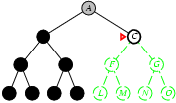
Depth-first search
Expand deepest unexpanded node Implementation:
fringe = LIFO queue, i.e., put successors at front

Slide 22
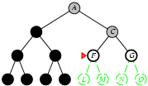
Depth-first search
Expand deepest unexpanded node
Implementation:
fringe = LIFO queue, i.e., put successors at front

Slide 23
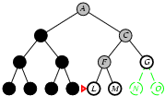
Depth-first search
Expand deepest unexpanded node Implementation:
fringe = LIFO queue, i.e., put successors at front

Slide 24
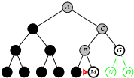
Depth-first search
Expand deepest unexpanded node
Implementation:
fringe = LIFO queue, i.e., put successors at front

Slide 25
Properties of depth-first search
Complete? No: fails in infinite-depth spaces, spaces with loops
Modify to avoid repeated states along path → complete in finite spaces
Time? O(b^{m}): terrible if m is much larger than d
but if solutions are dense, may be much faster than breadth-first
Space? O(bm), i.e., linear space!
Optimal? No

Slide 26
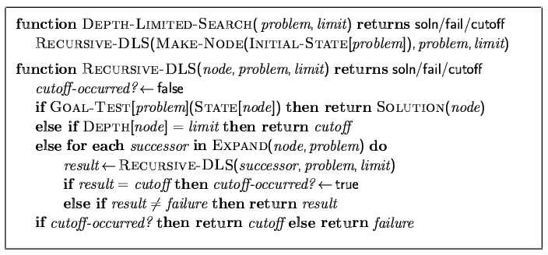
Depth-limited search
= depth-first search with depth limit l,
i.e., nodes at depth l have no successors
Recursive implementation:

Slide 27
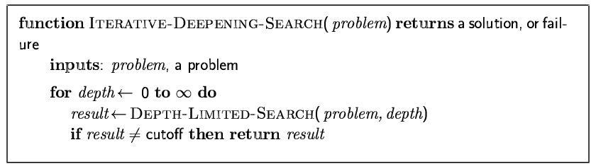
Iterative deepening search

Slide 28
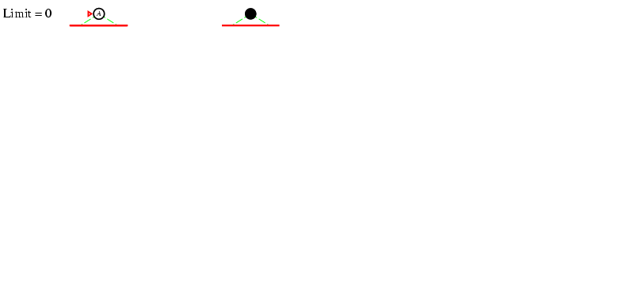
Iterative deepening search l =0

Slide 29
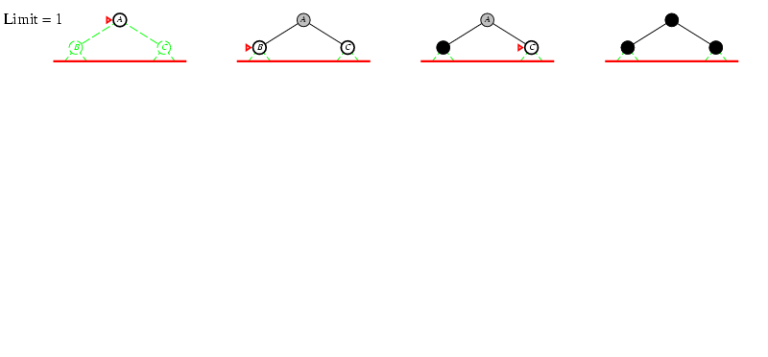
Iterative deepening search l =1

Slide 30
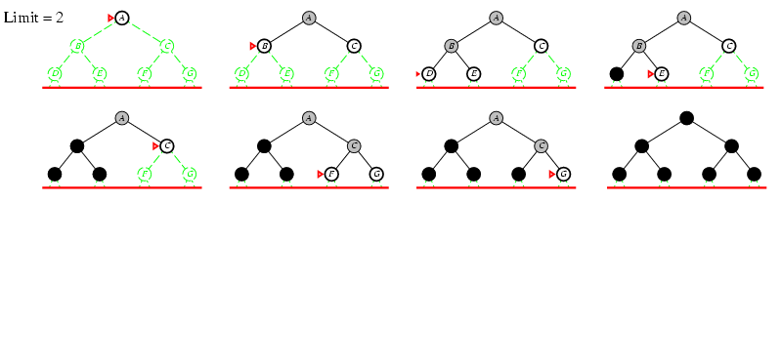
Iterative deepening search l =2

Slide 31
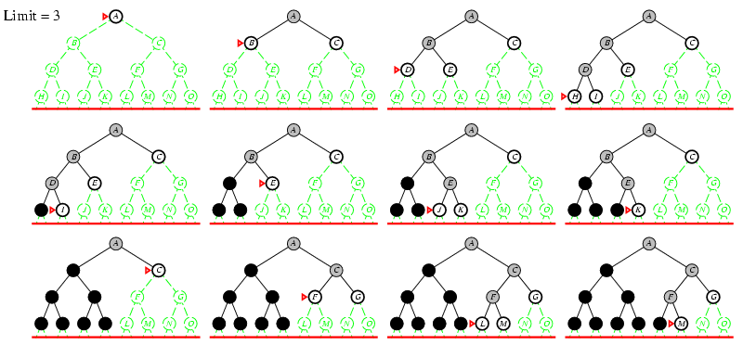
Iterative deepening search l =3

Slide 32
Iterative deepening search
Number of nodes generated in a depth-limited search to depth d with branching factor b:
N_{DLS} = b⁰ + b¹ + b² + … + b^{d-2} + b^{d-1} + b^{d}
Number of nodes generated in an iterative deepening search to depth d with branching factor b:
N_{IDS} = (d+1)b⁰ + d b^¹ + (d-1)b^² + … + 3b^{d-2} +2b^{d-1} + 1b^{d}
For b = 10, d = 5,
N_{DLS} = 1 + 10 + 100 + 1,000 + 10,000 + 100,000 = 111,111
N_{IDS} = 6 + 50 + 400 + 3,000 + 20,000 + 100,000 = 123,456
Overhead = (123,456 - 111,111)/111,111 = 11%

Slide 33
Properties of iterative deepening search
Complete? Yes
Time? (d+1)b⁰ + d b¹ + (d-1)b² + … + b^{d} = O(b^{d}) Space? O(bd) Optimal? Yes, if step cost = 1

Slide 34
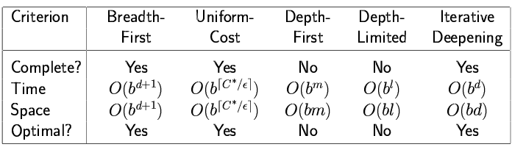
Summary of algorithms

Slide 35
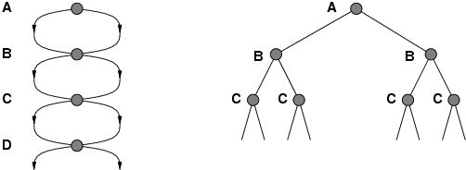
Repeated states
Failure to detect repeated states can turn a linear problem into an exponential one!

Slide 36
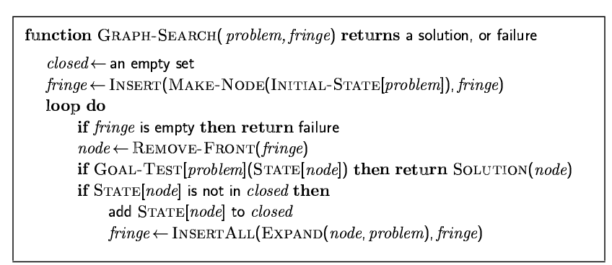
Graph search

Slide 37
Learning Outcomes with the Topic
Understanding the need of Search Algorithms

Slide 38
Methodology And Assessment Criterias
Class Assignment(s)
Each chapter being covered will have one assignment. The Case Studies will be given in line to the Changing with Speed across IT Projects in Kirirom
Internal Exam(s)
There will be 2 exams
Model Exam
There will be one Model Exam.
Semester Exam
There will be 1 Semester Exam

Slide 39
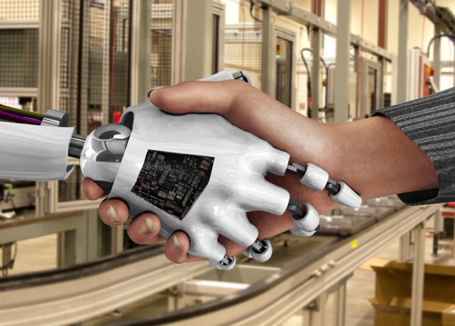
Thank You !
“An Algorithm Must Be Seen to Be Believed”
- Donald Knuth

